Slide 1


E-Commerce Sales Insights
By Chanda Kumari

Slide 2

CONTENTS
1. Interactive Report
2. Objective
3. Dashboard Features
4. Key Metrics (KPI Cards)
5. Sales by Geography
6. Sales by Category & Market
7. Shipment Mode Analysis
8. Conclusion & Next Steps

Slide 3

01
Interactive Report

Slide 4
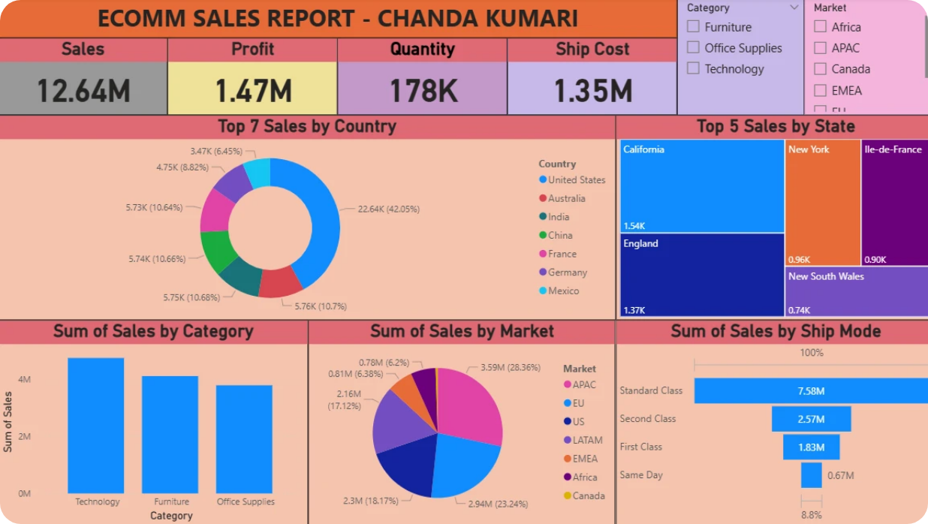
Interactive Report

Slide 5

02
Objective

Slide 6

Objective
Provide actionable insights on sales performance.
Identify top-performing countries, states, categories, and shipment modes.
Enable interactive exploration of sales, profit and shipment data.

Slide 7

03
Dashboard Features

Slide 8




Dashboard Features
Interactive filters and slicers for dynamic analysis.
Custom measures to calculate key metrics.
Visual storytelling with engaging charts and KPIs.
Drill-down capabilities for exploring sales patterns.

Slide 9

04
Key Metrics (KPI Cards)

Slide 10




Key Metrics (KPI Cards)
Total Sales
Total Profit
Total Quantity
Shipment Cost
12.64M
1.47M
178K
1.35M

Slide 11

05
Sales by Geography

Slide 12
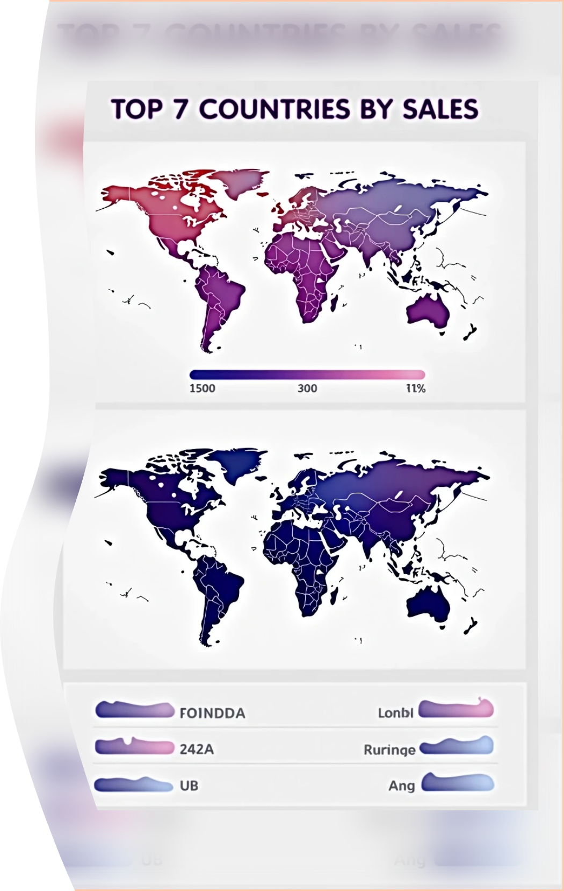
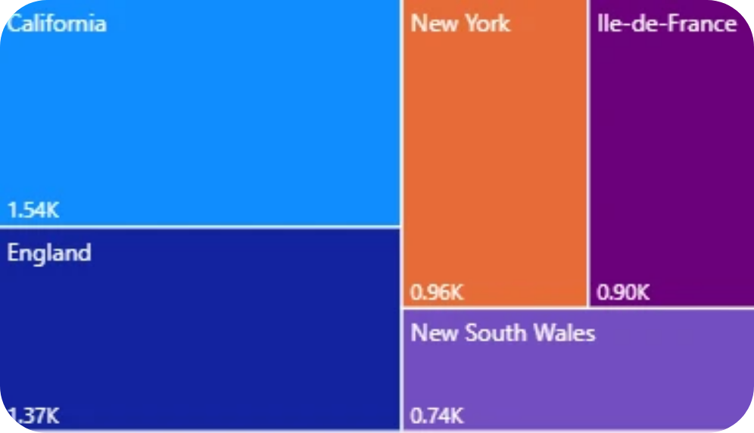
Sales by Geography
Top 7 Sales by Country
Top 5 Sales by State
Insights:
👉US region has the highest sales contributing 42% of the total revenue.
👉Countries with highest sales are US followed by Australia, India, China, France , Germany and Mexico.
👉5 most selling states are :

Slide 13

06
Sales by Category & Market

Slide 14

Sales by Category & Market
Breakdown of sales across product categories.
Performance comparison across different markets.
Insights:
👉 Technology is the best selling category among all with 4.74M of total sales.
👉 Asian Pacific Markets perform better in comparison with Europe,US and other markets.

Slide 15

07
Shipment Mode Analysis

Slide 16

Shipment Mode Analysis
Sales by shipment mode.
Cost and efficiency comparison.
Insights:
👉 7.58M sales have been done by standard class shipment mode
👉1.42M by Second class and
👉0.98M by First Class.

Slide 17
08
Conclusion & Next Steps

Slide 18

Conclusion & Next Steps
Strongest sales come from [top country/state/category].
Shipment costs highlight opportunities for logistics optimization.
Recommendation: Focus on high-profit categories and top regions to scale growth.

Slide 19
Thank You

